Slide 1
Milepæl a
Gruppe 2: LHEK

Slide 2
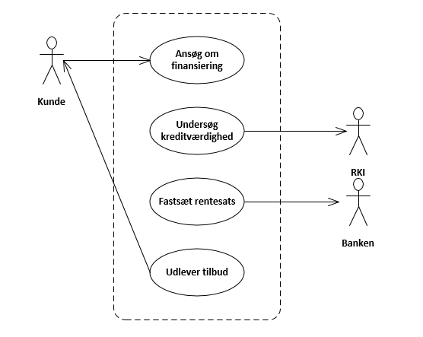
BPR: Use Case Diagram

Slide 3
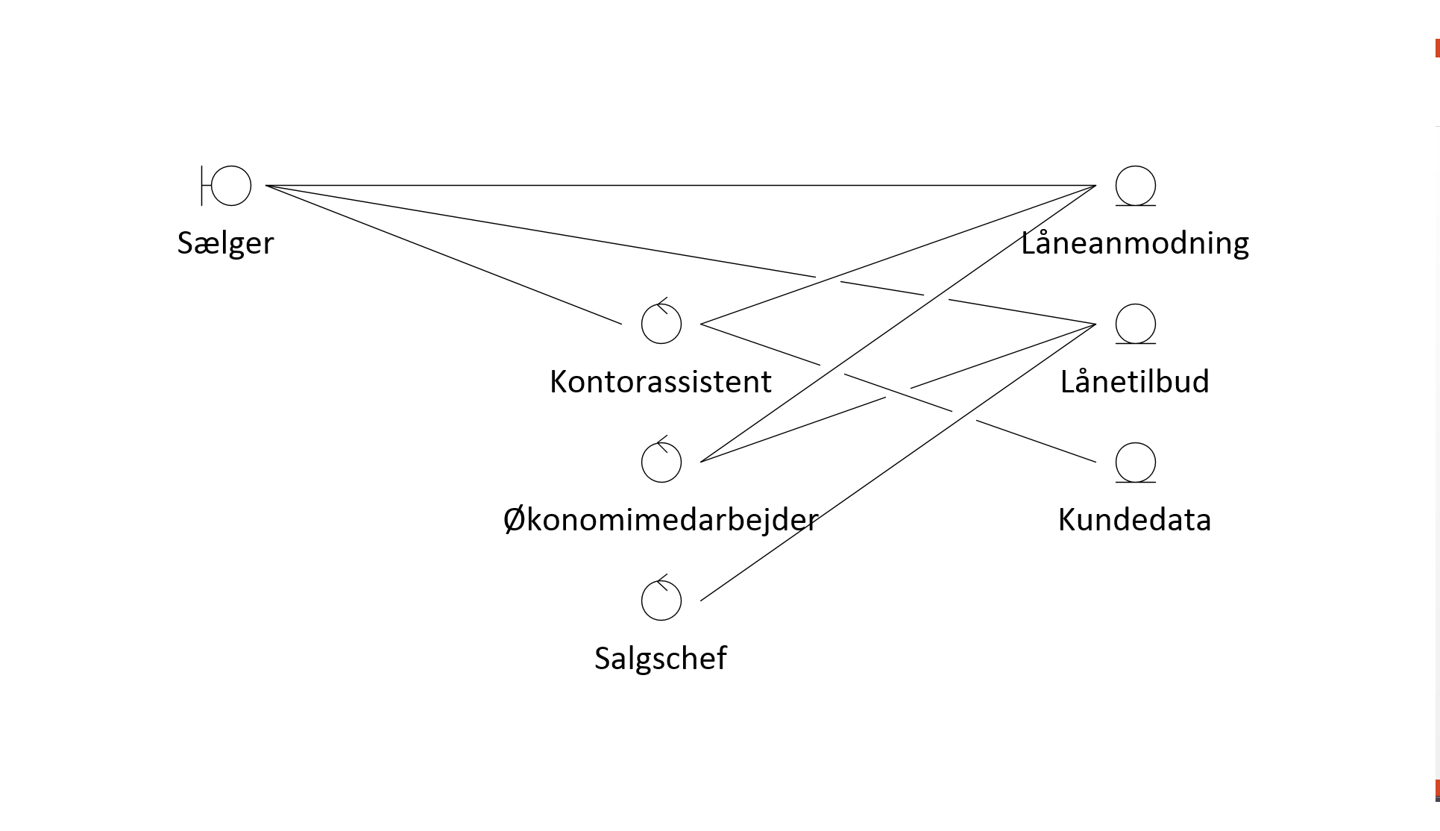
BPR Analyse: Objekt Model

Slide 4
Faseplan

Slide 5
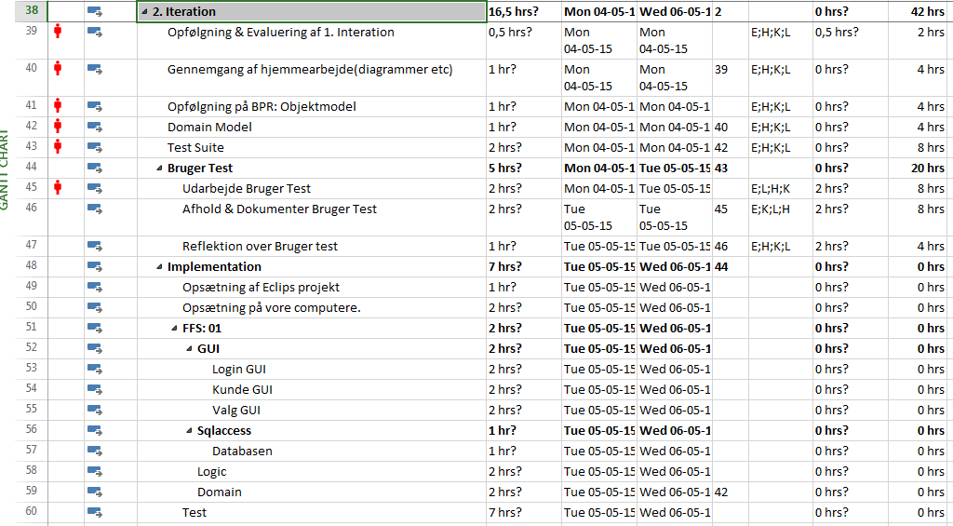
Iterationsplan for iteration 2

Slide 6
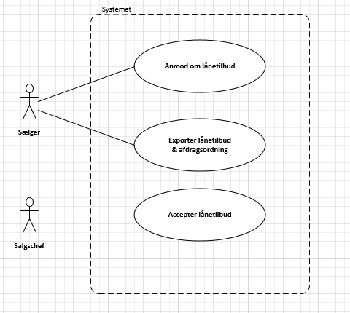
Overblik over identificerede use case

Slide 7
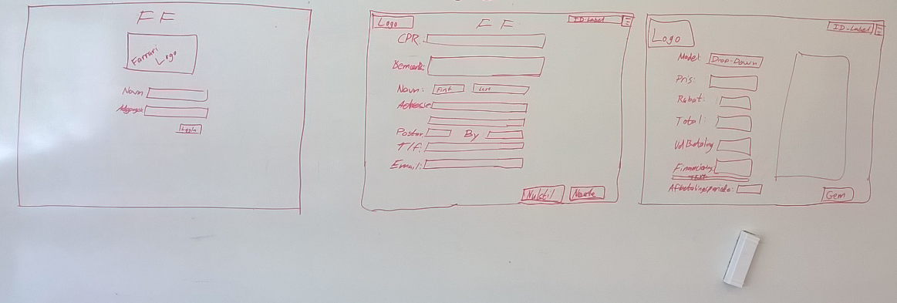
Mockups for FF1

